Slide 1
Everything You Ever Wanted Know About the BEA Regional Property Income Estimates
Mauricio Ortiz
Pacific Northwest Regional Economic Conference
Seattle, Washington
May 17, 2012

Slide 2
Personal Income
Personal Income includes:
Net Earnings (Wages + Supplements to Wages, + Proprietors Income, - Contributions for Social Insurance + Residence Adjustment)
Property Income (Dividends, Interest, Rent, & Royalties)
Transfer Receipts (such as Social Security, Unemployment

Slide 3
Property Income
Dividends, Interest, Rent & Royalties
Dividend income is the cash and other assets, excluding the corporations’ own stock, received from U.S. and foreign corporations
Interest income is monetary and imputed interest received from all sources received by individuals, employee retirement plans, nonprofits, and by estates and trusts
Rental income (with capital consumption adjustment) is the net current-production income of persons from the rental of real property; the imputed net rental income of owner-occupants of housing; and the royalties received by persons from patents, copyrights, and rights to natural resources

Slide 4
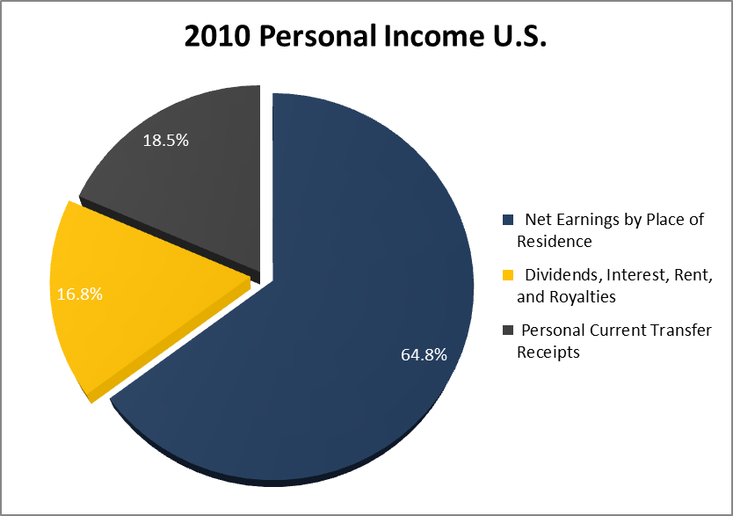
Components of Personal Income

Slide 5
Property Income: Pacific Northwest
Property income as a percent of personal income (2010)
Idaho: 18.3%
Montana: 21.3%
Nevada: 20.9%
Oregon: 18.7%
Utah: 16.5%
Washington: 18.5%
Wyoming: 24.3%

Slide 6
Property Income U.S.
Shown with the capital consumption adjustment

Slide 7
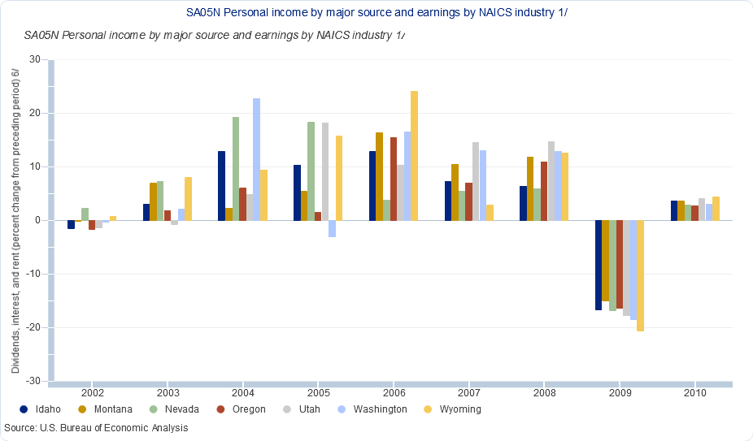
Property Income: Pacific Northwest

Slide 8
Property Income: BEA Public Detail
National and State
Personal dividend income
Personal interest income
Imputed interest income
Monetary interest income
Rental income of persons
Imputed rental income
Monetary rental income
Local Area
Dividend, interest, and rent

Slide 9
Property Income: BEA Internal Detail
Dividends received by individuals
Dividends received by employee retirement funds
Federal civilian government plans
State & Local government plans
Private noninsured plans
Dividends received by non-profit institutions
Dividends received by fiduciaries

Slide 10
Property Income: Source Data
Dividends
IRS tax return tabulations
Census Bureau
Survey of State and Local government public employee retirement systems
Consolidated Federal Funds Report
Civilian Population
Social Security Administration
BEA – RID income estimates

Slide 11
Property Income: BEA Internal Detail
Monetary interest received by individuals
Monetary interest received by employee retirement funds
Federal civilian government plans
Military plans
State & Local government plans
Private noninsured plans
Monetary interest received by non-profit institutions
Monetary interest received by fiduciaries
Accrued interest on unredeemed Federal government savings bonds
Imputed interest income

Slide 12
Property Income: Source Data
Interest
IRS tax return tabulations
Census Bureau
Finances of employee retirement systems of State and Local government
Consolidated Federal Funds Report
Civilian Population
Social Security Administration
BEA – RID income estimates
Department of the Treasury

Slide 13
Property Income: BEA Internal Detail
Net Rent and Royalties received by individuals
Net Rent and Royalties received by private noninsured pension plans
Net Rent and Royalties received by non-profit institutions
Net Rent and Royalties received by fiduciaries
Imputed Rental income

Slide 14
Property Income: Source Data
Rents and Royalties
IRS tax return tabulations
Census Bureau
American Community Survey
Civilian Population
Social Security Administration
BEA – RID income estimates

Slide 15
Property Income: 2013 Comprehensive Benchmark Revision
Accrual accounting for pensions
Interest income
Improvements to output measures of financial services
Interest income
Improvements to capitalize acquisition and disposal costs for real estate
Rental income

Slide 16
Questions
Contact Information:
Mauricio Ortiz
Regional Income Division
mauricio.ortiz@bea.gov
202-606-9269

